Slide 1
C++ Game Engine
James Price (19108410)

Slide 2
Project outcomes
To develop a 3D game engine using C++ with SDL2 and OpenGL
To create a main game scene that meets a set of assessment criteria and personal criteria
The game level will consist of a small village with basic buildings int it, with some large open spaces and wide roads, allowing players to run around shooting as well as getting into a tank and driving it around in 3rd person

Slide 3
Plan Overview
Stage One Requirements | Done | Stage Two Requirements | Done
FPS Camera | Yes | Height map terrain | No
Loading objects from file | Yes | Dynamic models | No
5+ static objects | Yes
Simple terrain | Yes
Moveable player | Yes
Textures | Yes
Skybox | No
Table 1: The list of different requirements for the assessment brief with Stage One being the 40% boundary and each Stage after that being the subsequent marking boundary

Slide 4
Plan Overview (Cont.)
Stage Three Requirements | Done | Stage Four Requirements | Done
Load from file without Assimp | Yes | Bump mapping | No
Heads Up Display / GUI | No | Lighting and shadows | No
 |  | Reflections | No
 |  | Particle systems | No
Table 2: A continuation of Table 1 with the final two stages for the marking criteria
Ideally the requirements chosen from the assessment criterial will be completed as soon as possible and then extra features from the criteria can be implemented

Slide 5
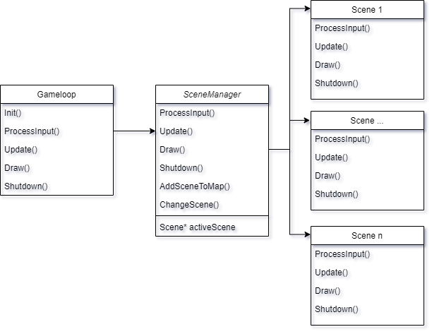
Scene manager
Figure 1: A basic diagram of how the Gameloop, SceneManager and Scenes are structured in the project

Slide 6
Current view of the game

Slide 7
Initial performance statistics

